Slide 1
Raining the Clouds Rodney Beede https://github.com/Coalfire-Research/raining-in-the-clouds

Slide 2
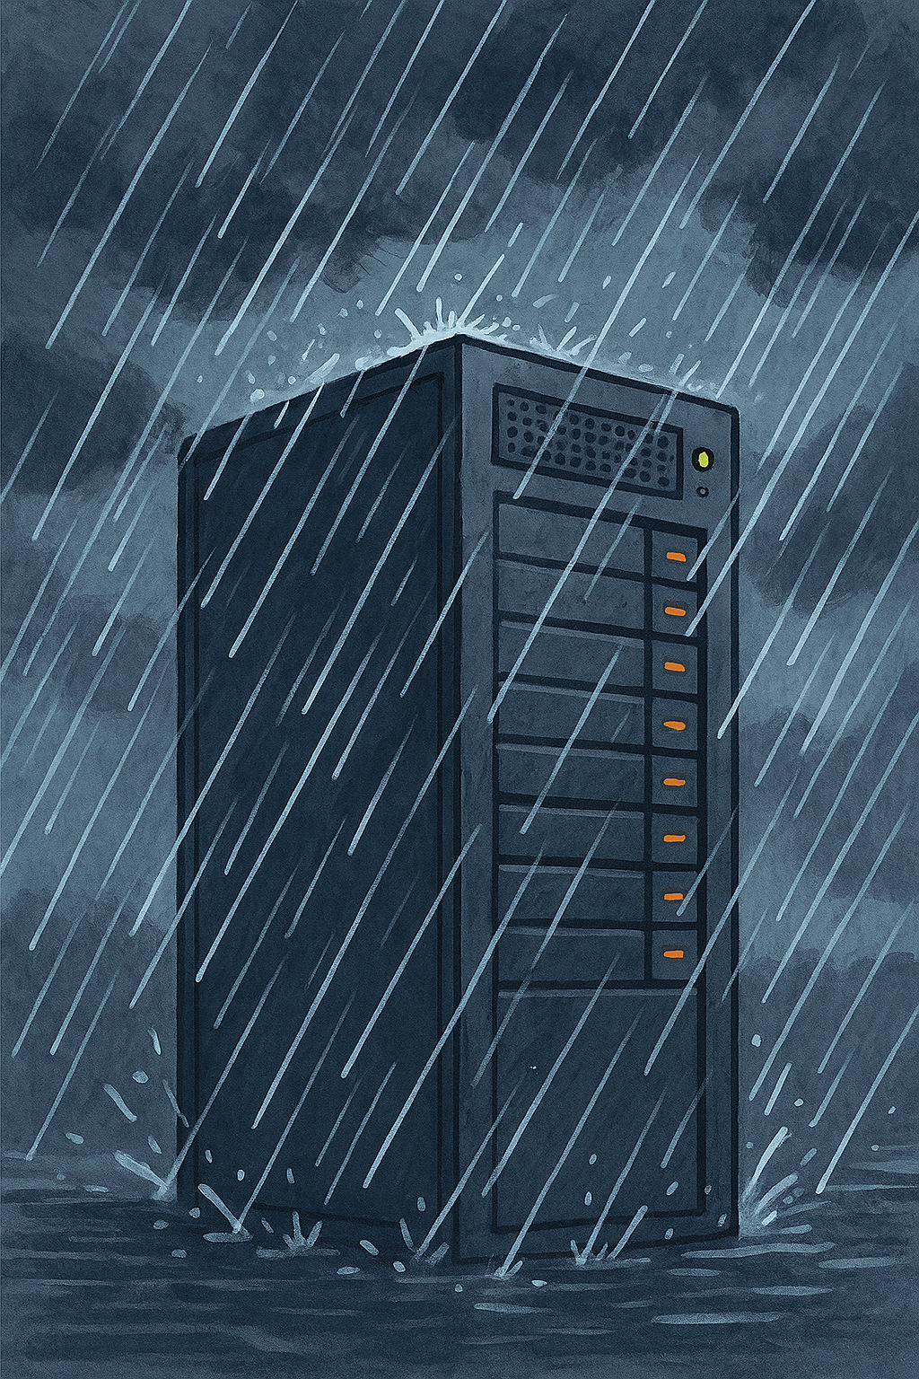
Pen Testing Cloud
Simulation Env.
Hands-on Practice
Authorization Vulns
XSS Injection
Encryption Bypass
Real Vulns
Cloud Stacks
OpenStack
Google Cloud
Salesforce
Learn the Tools
Exploit
See the Result

Slide 5
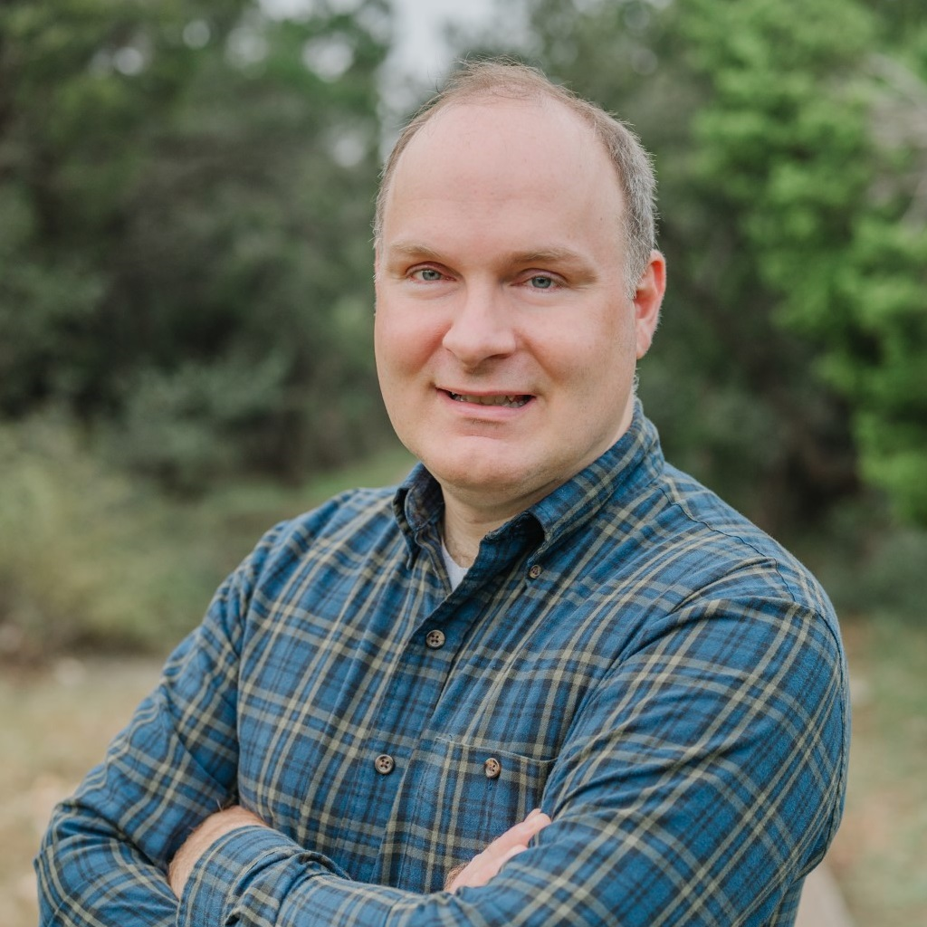
Bio
Rodney is a principal consultant and has specialized in cloud security for over 10 years. He has spoken at multiple conferences on topics from cloud security engineering to IoT device hacking. He has multiple CVEs for discovered web application security vulnerabilities. He started his career in enterprise web application software development but shifted to the security industry with this master's thesis research project "A Framework for Benevolent Computer Worms" 2012.
Rodney has spoken at conferences such as BSides, Black Hat, and Def Con.
https://www.rodneybeede.com/curriculum%20vitae/bio.html
https://www.blackhat.com/sector/2025/arsenal/schedule/#raining-the-clouds-47386

